Slide 1
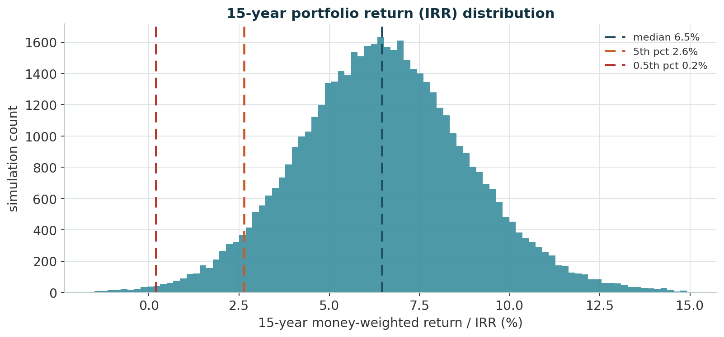
28
Returns – What the 15-Year Monte-Carlo Produces
50,000 paths on the actual funding waterfall; returns above the 1.0% guarantee on every percentile
MONTE-CARLO RETURN DISTRIBUTION
How the returns are simulated
• 50,000 paths, annual steps. €5.0bn into the matched bond book at t=0; €0.5bn/yr into the 14-index return portfolio, years 1–10.
• Multivariate Student-t (df 5), scaled so the shock covariance equals the 10-year historical covariance; geometric-mean drift; −99% floor.
• Realised in the sim: return portfolio 11.1% mean / 16.5% vol p.a., bond book 3.9% / 5.2% — in line with history.
What the returns say
• Median 15-year IRR 6.5% p.a. ≈ 550 bps above the 1.0% guarantee; mean annual return 6.6%.
• 5th-percentile path 2.6% p.a., 0.5th-percentile 0.2% — still positive, still ahead of the guaranteed accrual.
• Median assets at year 15 ≈ €22.0bn on €10.0bn of paid-in capital → median funded ratio 220%.
MEDIAN 15Y IRR
5TH-PCT IRR
0.5TH-PCT IRR
MEAN ANNUAL RETURN
6.5% p.a.
2.6% p.a.
0.2% p.a.
6.6%
money-weighted
clears the guarantee
still ≥ 0
contribution-stripped
Source: mc_lifecycle.py / results_var/MC_LIFECYCLE_REPORT.md.
CLIENT SITUATION | OUR SELLING POINTS | STRATEGIC CHALLENGES & MARKET OVERVIEW | PRODUCT STRATEGY | PORTFOLIO RESULTS | WHAT HAPPENS WITH THE UPSIDE

Slide 2
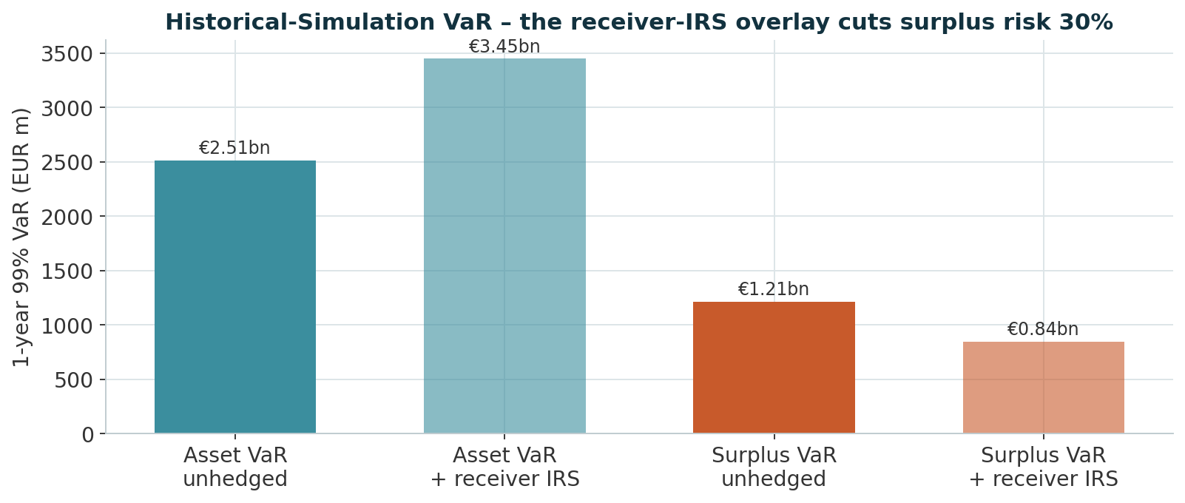
29
Keeping Within Our Risk Budget
The 1-year 99% VaR against the board's economic risk limit and the Solvency II requirement
1-YEAR 99% VAR VS. THE RISK LIMIT
Where the limit comes from
• Own funds (economic surplus) €3.19bn. Board funding-ratio floor 1.20 → max tolerable 1-year asset loss €1.83bn.
• Net of non-equity surplus risk, the equity 99% 1y VaR limit is €0.83bn — rule-derived, not an arbitrary %.
• Regulatory: SCR (99.5%, internal model) €0.94bn → Solvency II ratio ≈ 340%; MCR ≈ €0.23bn (> 1,300% covered).
Where we land
• Surplus 1y 99% VaR €1.21bn unhedged → €0.85bn with the receiver-IRS overlay (−30%); Asset VaR €2.51bn.
• Equity-futures overlay stays at 0% — the IRS already brings surplus risk inside the board limit.
• Monte-Carlo (Student-t + Heston VIX) surplus VaR €1.81bn — fatter tails, still well inside own funds.
SURPLUS VAR (HEDGED)
SCR (99.5%, 1Y)
SOLVENCY II RATIO
EQUITY FUTURES HEDGE
€0.85bn
€0.94bn
≈ 340%
0%
−30% vs unhedged
internal model
own funds / SCR
IRS frees the budget
Source: results_var/HS_REPORT_full_(unhedged|hedged).md, HS_REPORT_scr_irs.md, MC_REPORT_mc_full.md, SOLVENCY_II.md.
CLIENT SITUATION | OUR SELLING POINTS | STRATEGIC CHALLENGES & MARKET OVERVIEW | PRODUCT STRATEGY | PORTFOLIO RESULTS | WHAT HAPPENS WITH THE UPSIDE

Slide 3
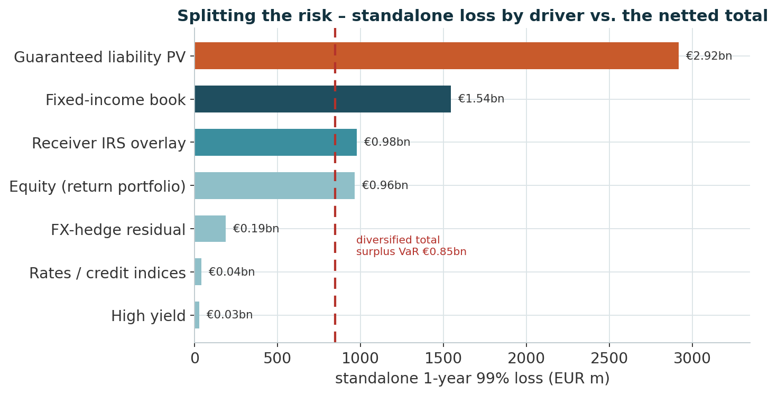
30
Splitting Up the Risk
Standalone 99% 1-year loss by driver — and why they net to a much smaller total
STANDALONE 99% 1-YEAR LOSS BY DRIVER
Rate risk nets out
• The guaranteed liability PV moves €2.92bn and the bond book €1.54bn on the same rate shocks — in the surplus they largely cancel (Surplus P&L = ΔAssets − ΔLiability).
• The receiver IRS (€0.98bn standalone) sits between them and closes the residual duration gap, so the surplus's net rate exposure is ≈ 0.
The risks we choose to run
• Equity €0.96bn — the deliberate risk budget, funded by surplus, never touching the guarantee.
• FX-hedge residual €0.19bn — the 1-year rate differential on rolling the USD→EUR hedges; HY and rates/credit indices negligible.
• Longevity is not a market-VaR driver — it is handled by buffer sizing and optional reinsurance.
The standalone losses sum to > €6bn but the diversified total surplus VaR is €0.85bn — the gap is diversification: rate moves hit assets and the liability together, and the IRS closes what is left.
CLIENT SITUATION | OUR SELLING POINTS | STRATEGIC CHALLENGES & MARKET OVERVIEW | PRODUCT STRATEGY | PORTFOLIO RESULTS | WHAT HAPPENS WITH THE UPSIDE

